Slide 1

-
Predictive Modeling for Disease Diagnosis Project Report
Presenter: Haruna Jallow
Internship : Mentorness Internship Program, 2024

Slide 2
Setup and Initialization
I imported all the libraries and utilities I needed for the project such as matplotlib, numpy, seaborn, sklearn for preprocessing the data, machine learning algorithms and matrices for evaluations
I also import the training and test datasets ie the CSV files that was given for the project
The training dataset (2351, 25) and test dataset (486, 25)

Slide 3
Data Preprocessing
Data preprocessing is a data mining technique that transforms raw data into an understandable format. This process has four main stages – data cleaning, data integration, data transformation, and data reduction
In the data cleaning process, I tired to filtered, detects, and handle noises, checked for outliers, duplicates, and missing values to ensure quality data and quality analysis results.
I transformed the “Disease” column to a Binary indicator (1: Diseased, 0: Non-diseased) for both the training and test datasets: ‘Anemia’: 1, ‘Healthy’: 0, ‘Diabetes’: 1, ‘Thalasse’: 1, ‘Thromboc’: 1, ‘Heart Di’:1

Slide 4
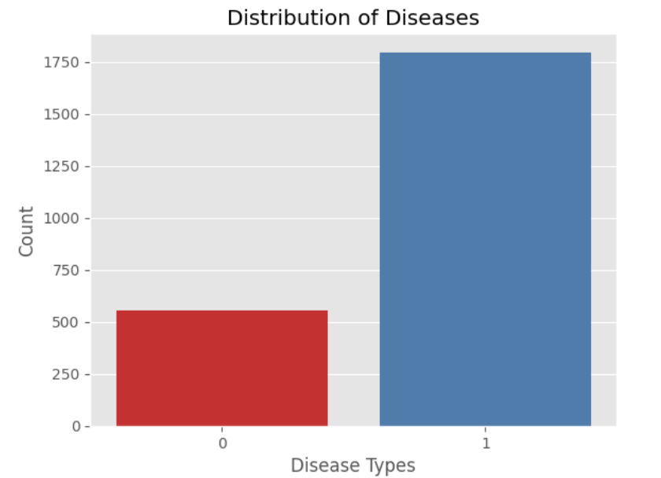
Exploratory Data Analysis (EDA)
EDA helps us to represent and visualize the data, to discover patterns, look over assumptions, and test hypothesis. It summarizes information on main characteristics and hidden trends in data.

Slide 5
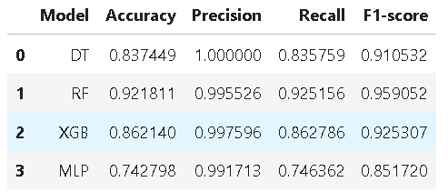
Machine Learning Models
The following machine Learning algorithms are chosen to fit to the datasets. These models should be classifiers for multi-class classification.
Decision Tree (DT)
Random Forest (RF)
XGB Classifier
Multilayer Perceptron (MLP)

Slide 6
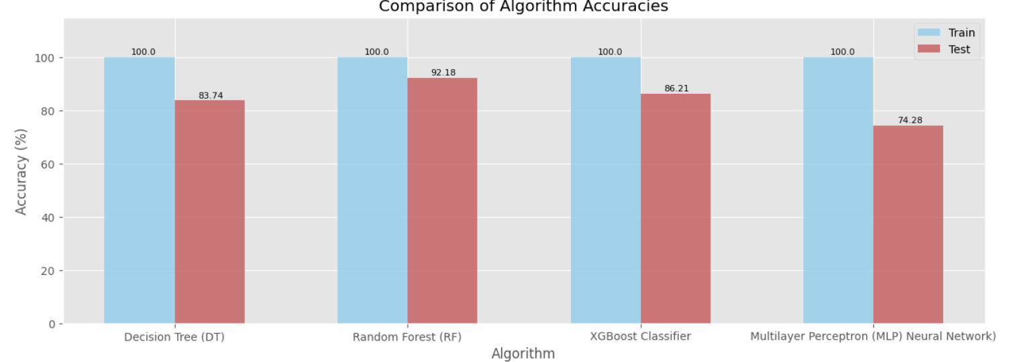
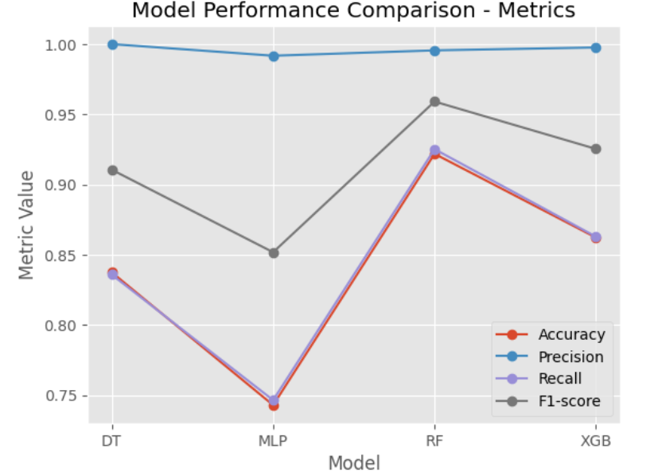
Cont.
Random Forest (RF) seems to perform the best overall due to its balanced precision and recall
Random Forest (RF) has the best performance for both the training and test accuracy

Slide 7
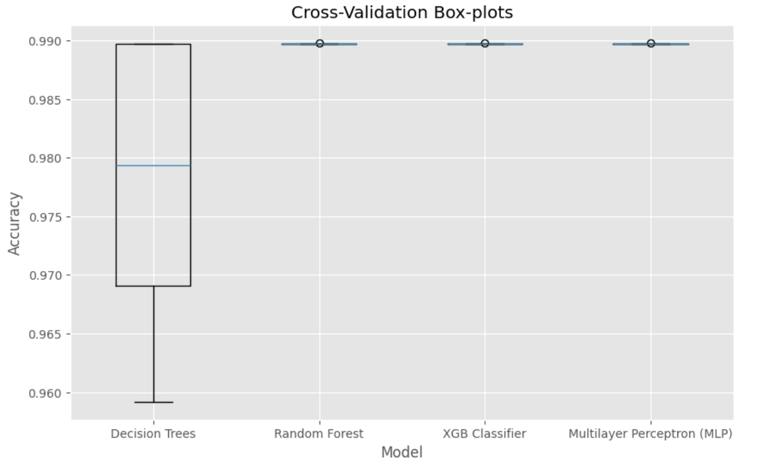
Comaprision of Models Using Cross-Validation Scores
After CV each model achieved perfect performance on each fold. This is indicated by a score of 1.0 for each fold and an average score of 1.0.
All models have consistently achieved a score of 1.0 across all folds except that DT, indicating very high or perfect performance.

Slide 8
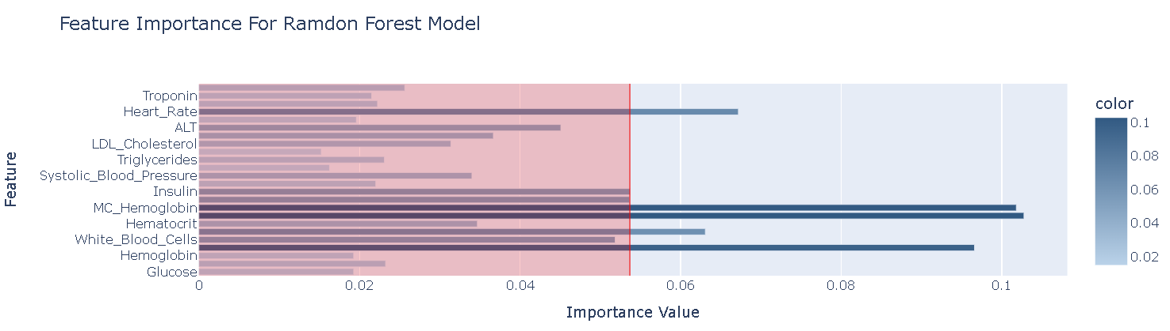
Model Interpretation
The final crucial step of a data science project is the interpretation of the models and data, in terms of its predictive power and thus its ability to generalise unseen future data
Predicted class label:
['Thromboc’: 1] ie Diseased

Slide 9

Analysis of Results (Classification)
1st Most Stable
Random Forest
2nd Most Stable
XGB Classifier
3rd Most Stable
Decision Tree
least reliable
Multilayer Perceptron (MLP)

Slide 10
THANKS!
Q&A

